Slide 1
Intrinsic Motivation and Growth Mindset
How to inspire life long learning
By Molly Cunningham
Dec 2, 2020

Slide 2
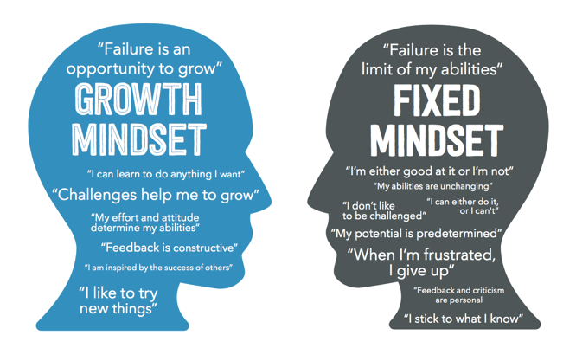
How can teachers create an engaging learning environment and encourage intrinsic motivation?
Core Competencies
Personal and professional preparation:
Developing a growth mindset demonstrated in collaboration with others.
Notes:
My inquiry proposal question is “How can teachers create an engaging learning environment and encourage intrinsic motivation”?. Intrinsic motivation is not possible without students encompassing a growth mindset.
Therefore, in the list of core competencies, my inquiry is related to ”developing a growth mindset demonstrated in collaboration with others”.
One with a growth mindset, believes that goals are attainable through hard work and dedication.
It creates a love for learning and shapes the future for education.
For this presentation, I will share what intrinsic motivation is, how it relates to growth mindset and how future teachers can encourage and motivate children to find passions, search for new findings, and develop a love for learning.
References:
http://teachered.ca/competency-2/

Slide 3
“Intrinsic motivation is the goal setting and drive that comes from the motivation to succeed as an individual without the influence of external factors” –Hayley Atkins
Notes:
This is a quote that I had heard while interviewing teachers within my community.

Slide 4
Why intrinsic motivation?
Instill a love for learning
Engage students
Advance student achievement
Notes:
My teaching philosophy has always been to motivate children to love learning, and develop the best way to teach this. I wanted to present a proposal that was going to encourage future teachers to teach in a way that shows students how much fun and rewarding learning can be.
At the beginning of the year, I had no idea what intrinsic motivation was, however, I knew I wanted to structure my inquiry proposal around a passion for learning. Kristen introduced intrinsic motivation to me and helped shape my question in a way that was professional, and provided me with several resources to develop my inquiry further.
I soon researched intrinsic motivation and how to use it in my own life, and then learned how I could implement it in my future classroom.

Slide 5
What is the difference between Intrinsic and extrinsic motivation?
Extrinsic
Fixate on the “what”
Short-term mindset
rewards
Intrinsic
Focus on the “why” of learning
Desire to learn
Positive feedback
Notes:
● The old curriculum was centred around extrinsic motivation and focused more on external motivation, referring to incentives to encourage success and productivity, without knowing the consequences. Extrinsic motivation often focuses on grades and performance and motivates students through external rewards (Davis, n.d.). Specifically, this gives students the wrong idea that ability should be rewarded over effort (Freidenberg, 2016). Overall, it provides students with a short-term mindset weakening their academic achievement (Friedenberg, 2016).
● In contrast, intrinsic motivation focuses on the student's internal motivation, through goals and from the motivation to succeed as an individual (Davis, n.d.). Further, it focuses on the relevance of why the teacher is teaching, and the importance of learning (Freidenberg, 2016). Intrinsic motivation in the classroom leads students in becoming empowered, independent, and to work collaboratively (Valerio, 2012). Overall, intrinsic motivation initiates a drive to learn and promotes a desire for students to engage in classroom discussion (Valerio, 2012).

Slide 6
Growth Mindset
Learning is my goal
I Can Get Smarter
Id spend more time and work harder
Higher Achievement
Effort makes me stronger
“Today I will do what others won’t so tomorrow I can accomplish what others can’t” – Jerry Rice
Notes:
Regarding this diagram, growth mindset is the believe that goals are reached through effort, whereas a fixed mindset believes goals are reached through talent or natural ability (Freidenberg, 2016). In my opinion, growth mindset and intrinsic motivation are linked and students need both to grow and reach their full learning potential. To support and shape a growth mindset in students, teachers must provide praise towards effort to amplify their learning, rather than intelligence, which hinders their motivation (Freidenberg, 2016).

Slide 7
Why should teachers use intrinsic motivation?
Improves students motivation
Increases productivity
Students are prepared for life
Notes:
Intrinsic motivation is critical in improving student’s learning, productivity, and life achievement (Valerio, 2012).
Students motivation quickly improves when school work is geared more towards their choices and passions (Yazdi, 2016). With more flexibility and focus on the students learning outcomes, rather than students’ grades, it allows them to take more risks and develop a deeper level of understanding (Valerio, 2012) .
Students start to take control of what they want to learn and develop deeper understandings for material they are curious and passionate about (Atkins, 2020) .
Finally, students become prepared for life, by developing a growth mindset, which opens up a world of possibilities to improve and learn (Freidenberg, 2016). This way of life encourages life-long learning and increases success for students, athletes, and life achievement (Freidenberg, 2016).
Reference:
(H. Atkins, Personal communication, November 4th, 2020).
Photo: https://www.wooclap.com/en/blog/inside-classrooms/improving-student-performance-through-intrinsic-motivation/

Slide 8
How can teachers create an engaging learning environment and encourage intrinsic motivation?

Slide 9
1. Providing a supportive environment
Setting high expectations
Learning outcomes that fit with the Zone of Proximal Development
Teacher and student work collaboratively
Using group work
Notes:
To guide intrinsic motivation in your classroom, one must have a supportive atmosphere and embellish a creative environment (Valerio, 2012) . As a teacher, set high expectations for your students allowing them to achieve their ultimate learning abilities. In addition to this, provide learning outcomes to fit with the student’s zone of proximal development (Valerio, 2012). That is to say, for your students to reach their potential, set tasks and goals that are challenging, however, achievable through feedback and support (Valerio, 2012) . Collaboration and group work helps lower anxiety and initiates students to deepen their understanding. Further, make sure the classroom is free from discrimination and everyone is exhibiting mutual respect (Valerio, 2012) . Therefore, more students will participate and take risks, without the fear of being incorrect.
Photo reference: https://www.innovativeeducators.org/products/front-line-customer-service-creating-an-inclusive-supportive-environment-for-differently-abled-students

Slide 10
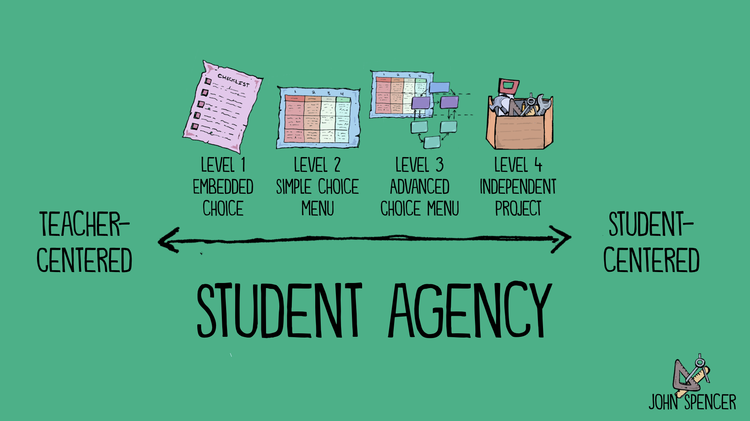
2. Allowing students choice and control
Goal setting to develop positive thought
Assistance in lessons
Guided self-reflection
Fosters motivation
Notes:
Allowing students the opportunity to participate and engage with the lesson plan will will give them a sense of ownership of their learning, all while finding new knowledge and skills to learn (Valerio, 2012)
Teaching students to set attainable and achievable goals is important for student growth (Valerio, 2012). This develops positive thoughts, increases confidence and facilitates persistence (Valerio, 2012) .
”Student choice is more than simply picking a task. Its about owning the entire learning process”- John Spencer
Photo reference: http://www.spencerauthor.com/choice-menus/

Slide 11
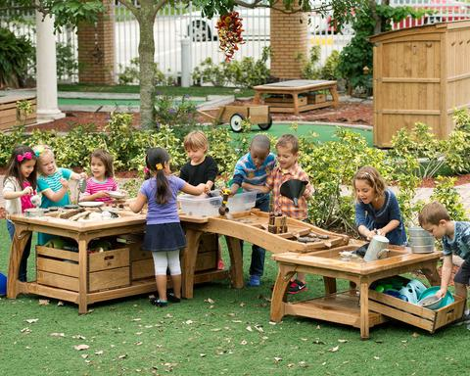
3. Providing engaging lessons
Rich-learning experiences
Immersing students in meaningful tasks
Grabs attention and engagement
Notes:
Grabbing students attention, and providing fun lesson plans will engage the class, which increases participation and student awareness (Valerio, 2012). Structuring lessons within the community, utilizing resources, and providing theatre activities develops a rich learning experience for students and will foster inspiration and motivation (Valerio, 2012) .
Photo reference: https://www.google.com/url?sa=i&url=https%3A%2F%2Flouisekool.com%2Fcollections%2Foutdoor-learning&psig=AOvVaw09AG66O8oku_XsbT7lJ6kB&ust=1606436852986000&source=images&cd=vfe&ved=0CAkQjhxqFwoTCLi8ueT5nu0CFQAAAAAdAAAAABAk

Slide 12
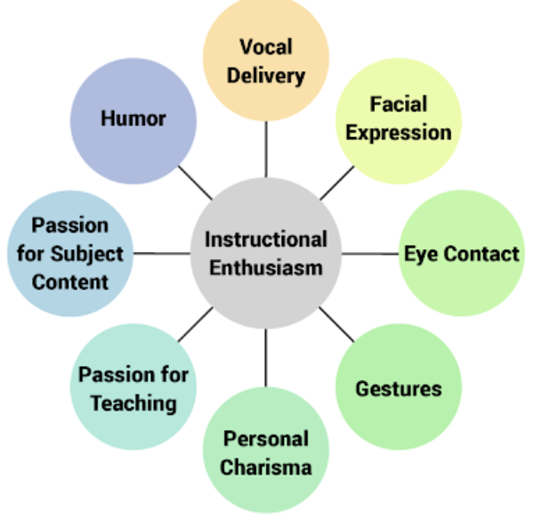
4. Expressing passion and enthusiasm
Teachers passion increases the energy in the classroom
Positive energy helps motivate students
Planning lessons that cater towards students strengths
Notes:
Most importantly, intrinsic motivation is encouraged through the teacher’s energy (Valerio, 2012). Passion and enthusiasm motivate and intrigues students to want to learn more (Valerio, 2012). Your energy as a teacher is reflected in your student’s desire to learn and understand (Valerio, 2012). Providing lessons structured around student's goals and ambitions will enhance and stimulate their understanding (Valerio, 2012).
Photo reference: http://www.learningenvironment.ctl.gatech.edu/enthusiasm/

Slide 13
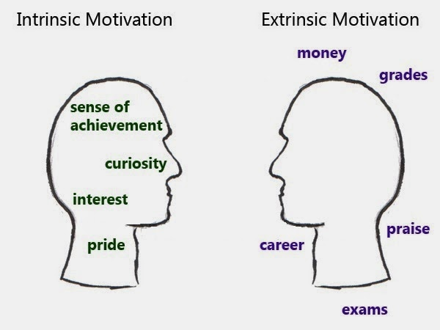
When to reward students?
For:
Seeking new challenges
Displaying curiosity for new learning
Positive feedback
Promoting interest to learn new skills
Notes:
Rewards and external incentives, if used correctly, are a beneficial tool in the classroom, however, if used incorrectly decrease intrinsic motivation, and fosters short-term production, limiting motivation (Kristen, 2020).
I Interviewed several teachers in our community, many teachers use rewards, however not to congratulate students on completing a task or getting a good mark on an exam, rather, many teachers provide rewards when students seek new challenges, use curiosity in their studies, and complete tasks to discover new material they are passionate about (Atkins, 2020). Kristen gives out rewards when her students least expect it, and most deserve it.
Positive praise and feedback is a way teachers can reward their students, however, teachers must remember to only praise meaningful work and be intentional, specific, and direct in their feedback to help students understand and improve (Valerio, 2012).
References:
(H. Atkins, Personal communication, November 4th, 2020).
(K. Sinats, Personal communication, November 4th, 2020).
Photo: https://commons.wikimedia.org/wiki/File:Intrinsic_Vs_Extrinsic_Motivation.jpg

Slide 14
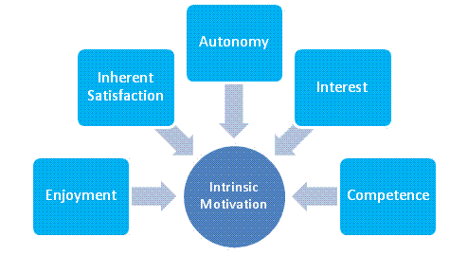
MY Learnings
Teacher interviews
Goals
Outcomes
Examples
Resources
Notes:
My interviews showed me how to implement intrinsic motivation in the classroom and provide children with a growth mindset. These Wednesday visits clearly showed me how passionate students are at such a young age, and how motivated they are to learn. The teachers, students, and overall experience provided me with so many resources to strengthen my understanding of intrinsic motivation, and how to implement it into a classroom.
Kristen discusses how long term, students need to learn to do things for themselves, and not for a reward. Her goal is to create an environment of learners, where students have purpose and intention, and understand the value of what they are being taught. She believes grades limit learners and instead effort and thought allows students to walk away with more knowledge than achieve a higher outcome. Letting students guide the classroom, and allowing flexibility within the lesson plan is greatly beneficial to their motivation and productivity.
Hayley believes that intrinsic motivation shapes students into becoming hard-working students and life long learners. It helps the students develop confidence and find feedback within themselves, without the need for external feedback.
I would like to research more techniques and assignments I can use in the future to strengthen my students learning further, and learn from more teachers of how they implement intrinsic motivation in their classrooms.
References:
(H. Atkins, Personal communication, November 4th, 2020).
(K. Sinats, Personal communication, November 4th, 2020).
Photo reference: https://m0t1v8me.wordpress.com/2013/10/10/intrinsic-vs-extrinsic-motivation/.

Slide 15
THANK YOU!

Slide 16
References:
Cadwell, K. (2018). Students need to lead the classroom, not teachers. Retrieved October 20, 2020, from https://www.ted.com/talks/katherine_cadwell_students_need_to_lead_the_classroom_not_teachers
Mcdaniel, R. (2020). Motivating Students. Retrieved October 20, 2020, from https://cft.vanderbilt.edu/guides-sub-pages/motivating-students/
Freidenberg, A. (2016). Exploring the Link Between Intrinsic Motivation and the Growth Mindset. Retrieved from https://www.westpoint.edu/sites/default/files/inlineimages/centers_research/center_for_teching_excellence/PDFs/mtp_project_papers/Freidenberg_16.pdf
Yazdi, H. (2016). How Educators Can Foster Student Motivation. Retrieved October 20, 2020, from https://digitalpromise.org/2016/08/18/how-educators-can-foster-student-motivation/
Valerio, K. (2012). Intrinsic Motivation in the Classroom. Retrieved From; https://ro.uow.edu.au/cgi/viewcontent.cgi?referer=https://www.google.com/&httpsredir=1&article=1012&context=jseem
Davis, D. (n.d.). Shifting form Extrinsic to Intrinsic Motivation. Retrieved From https://leadinggreatlearning.com/shifting-from-extrinsic-to-intrinsic-motivation/

