Slide 1
Persuasion
Psychology 231
Notes:
How to change someone’s attitude or belief as a result of receiving a message

Slide 2
Attitude Changes
Notes:
I will be going through Cognitive Dissonance, Sequential Request Strategies,

Slide 3
Cognitive Dissonance
1. Initial Attitude
2. Counter attitudinal Behavior Attitude Change
3. Dissonance
Notes:
This is where an attitude change results from drive to reduce cognitive dissonance by reducing attitude-behavior inconsistency
Dissonance is a lace of harmony or agreement between two things. Cognitive dissonance causes feelings of unease and tension, and people attempt to relieve this discomfort in different ways. (rejecting new information that conflicts with their existing beliefs.

Slide 4
Sequential Request Strategies
Notes:
These are techniques used to persuade certain requests, and are usually carried out in a specific sequence. We will be covering the Foot-in-the door technique, Door-in-the-face Technique, and lowball techniques.

Slide 5
Foot In the door Technique
Small Request
Agreement
Large Request
Notes:
It works through the self perception theory, I am a nice person and then the second request they think okay I should help because they have established that they are a nice person.
Cognitive dissonance.

Slide 6
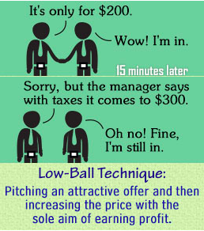
Low Balling
Request
Agreement
Hidden Cost
Notes:
A Person typically secures agreement with a request and then requester increases the size of that request by revealing hidden cost. It is very effective because of psychologt of commitment. This is used with insurance, retail.

Slide 7
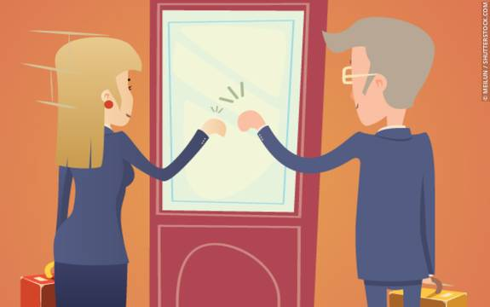
Door in the Face Technique
Make Large Request
Rejected
Make More Moderate Request
Notes:
Person begins with a very large request that will be rejected; then follows that up with a more moderate request.
Effective because:
We do not like to say no, and the 2nd request appears so much smaller.

